Slide 1
DEPARTMENT OF INFORMATION SCIENCE & ENGINEERING
“Airline ticket booking system using C++”
Presentation by,
Tarun Sharma

Slide 2
Agenda
Introduction
Problem Definition
Proposed system
Objectives
Design modules
Demonstration
Conclusion

Slide 3
Introduction
Flight Reservation System is based on a concept of booking and canceling flight reservations.
Here, the system contains no login feature. The users can easily book flights, cancel flight reservation, and check tickets. It contains different payment options.
This mini project contains fewer features but the essential ones.

Slide 4
Problem Definition
“To design and implement Airline ticket booking system with essential features using C++”

Slide 5
Objectives
To understand the complex procedure for booking flight tickets and implement only the essentials features using C++ language using the concepts of classes and objects.

Slide 6
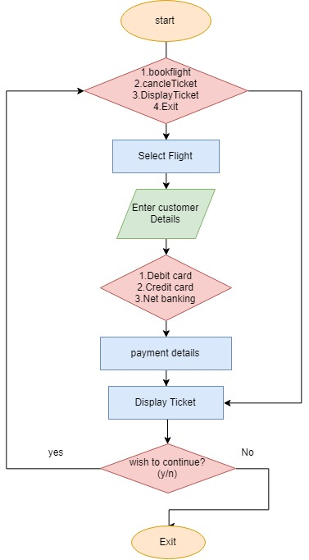
Design Modules
Flowchart:

Slide 7
Algorithm
Step 1: Start
Step 2: include required header files
Step 3: declare global variable
Step 4: create a class for domestic booking
Step 5: create a class for international booking
Step 6: create a class named passenger
Step 7: create a class payment
Step 8: create main function, declare objects
Step 9: End

Slide 8
Demonstration

Slide 9
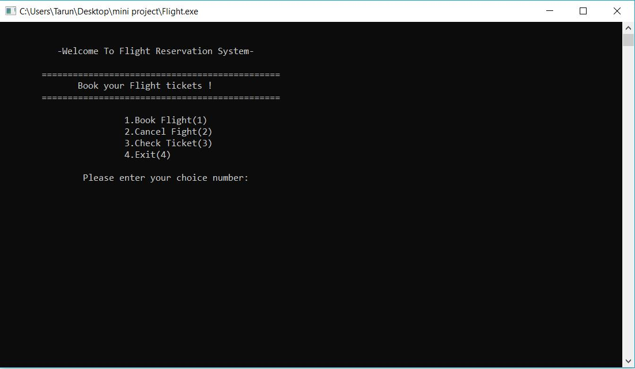
Output(Snaps)

Slide 10
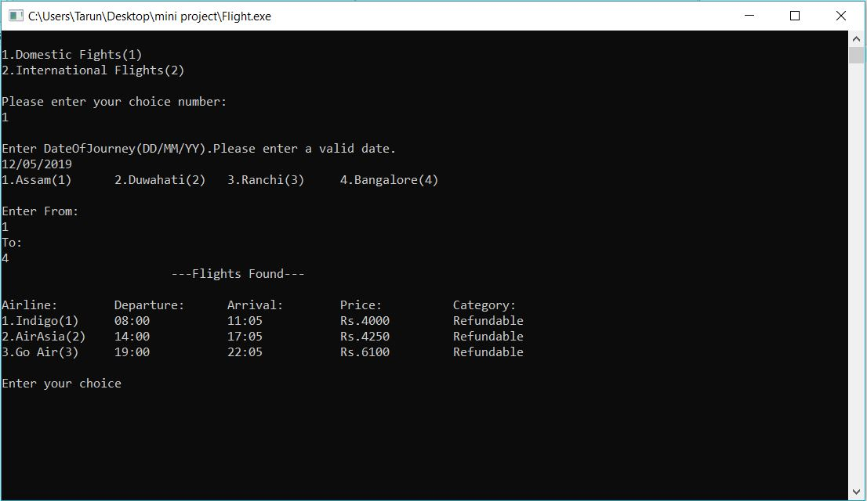

Slide 11
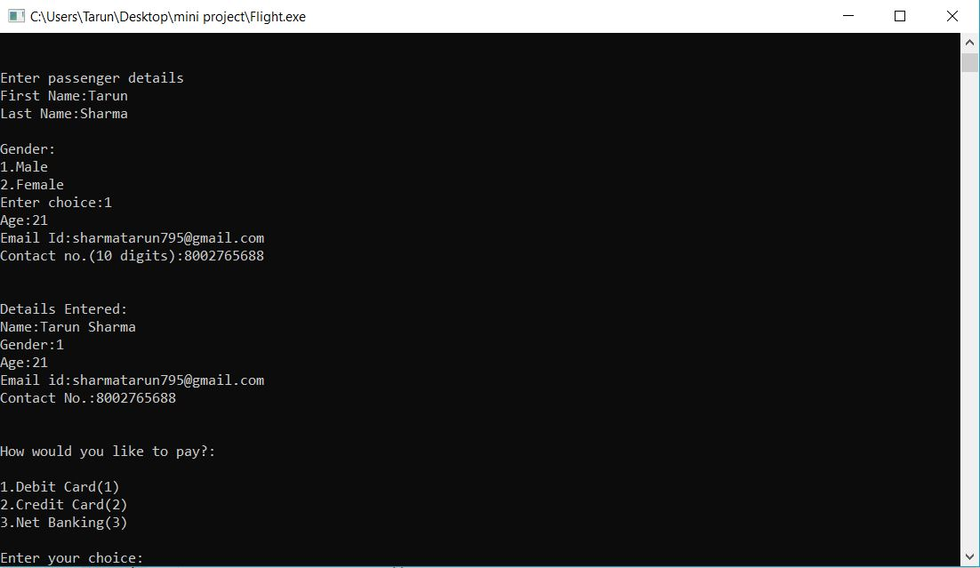

Slide 12
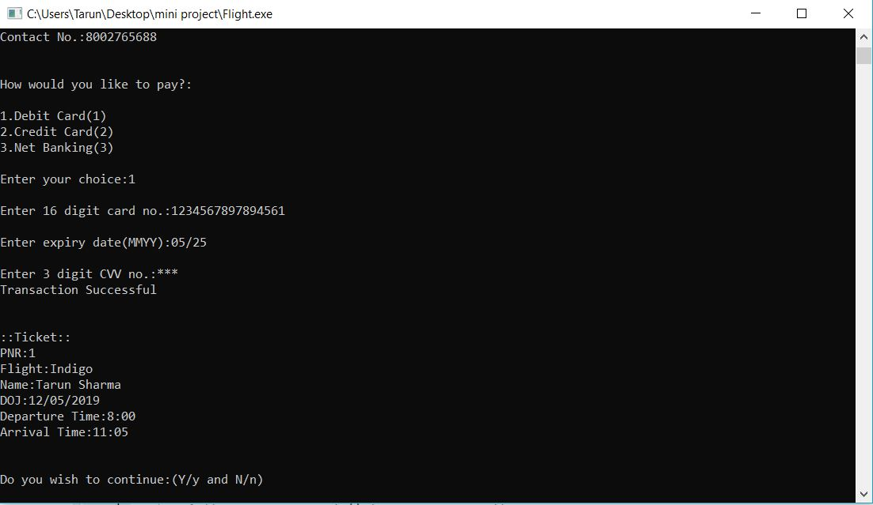

Slide 13
Conclusion
This application-project reduces the complicated work of the user and make it simpler by using only the essential features for booking the desired flight ticket.

Slide 14
References
[1] Bjarne Stroustrup,The C++ Programming Language (4th Edition)
[2] Balagurusamy, Object oriented programming using C++
Websites Used:
https://www.tutorialspoint.com/cplusplus/
https://www.geeksforgeeks.org/makefile-in-c-and-its-applications/

Slide 15
Thank you

